Slide 1
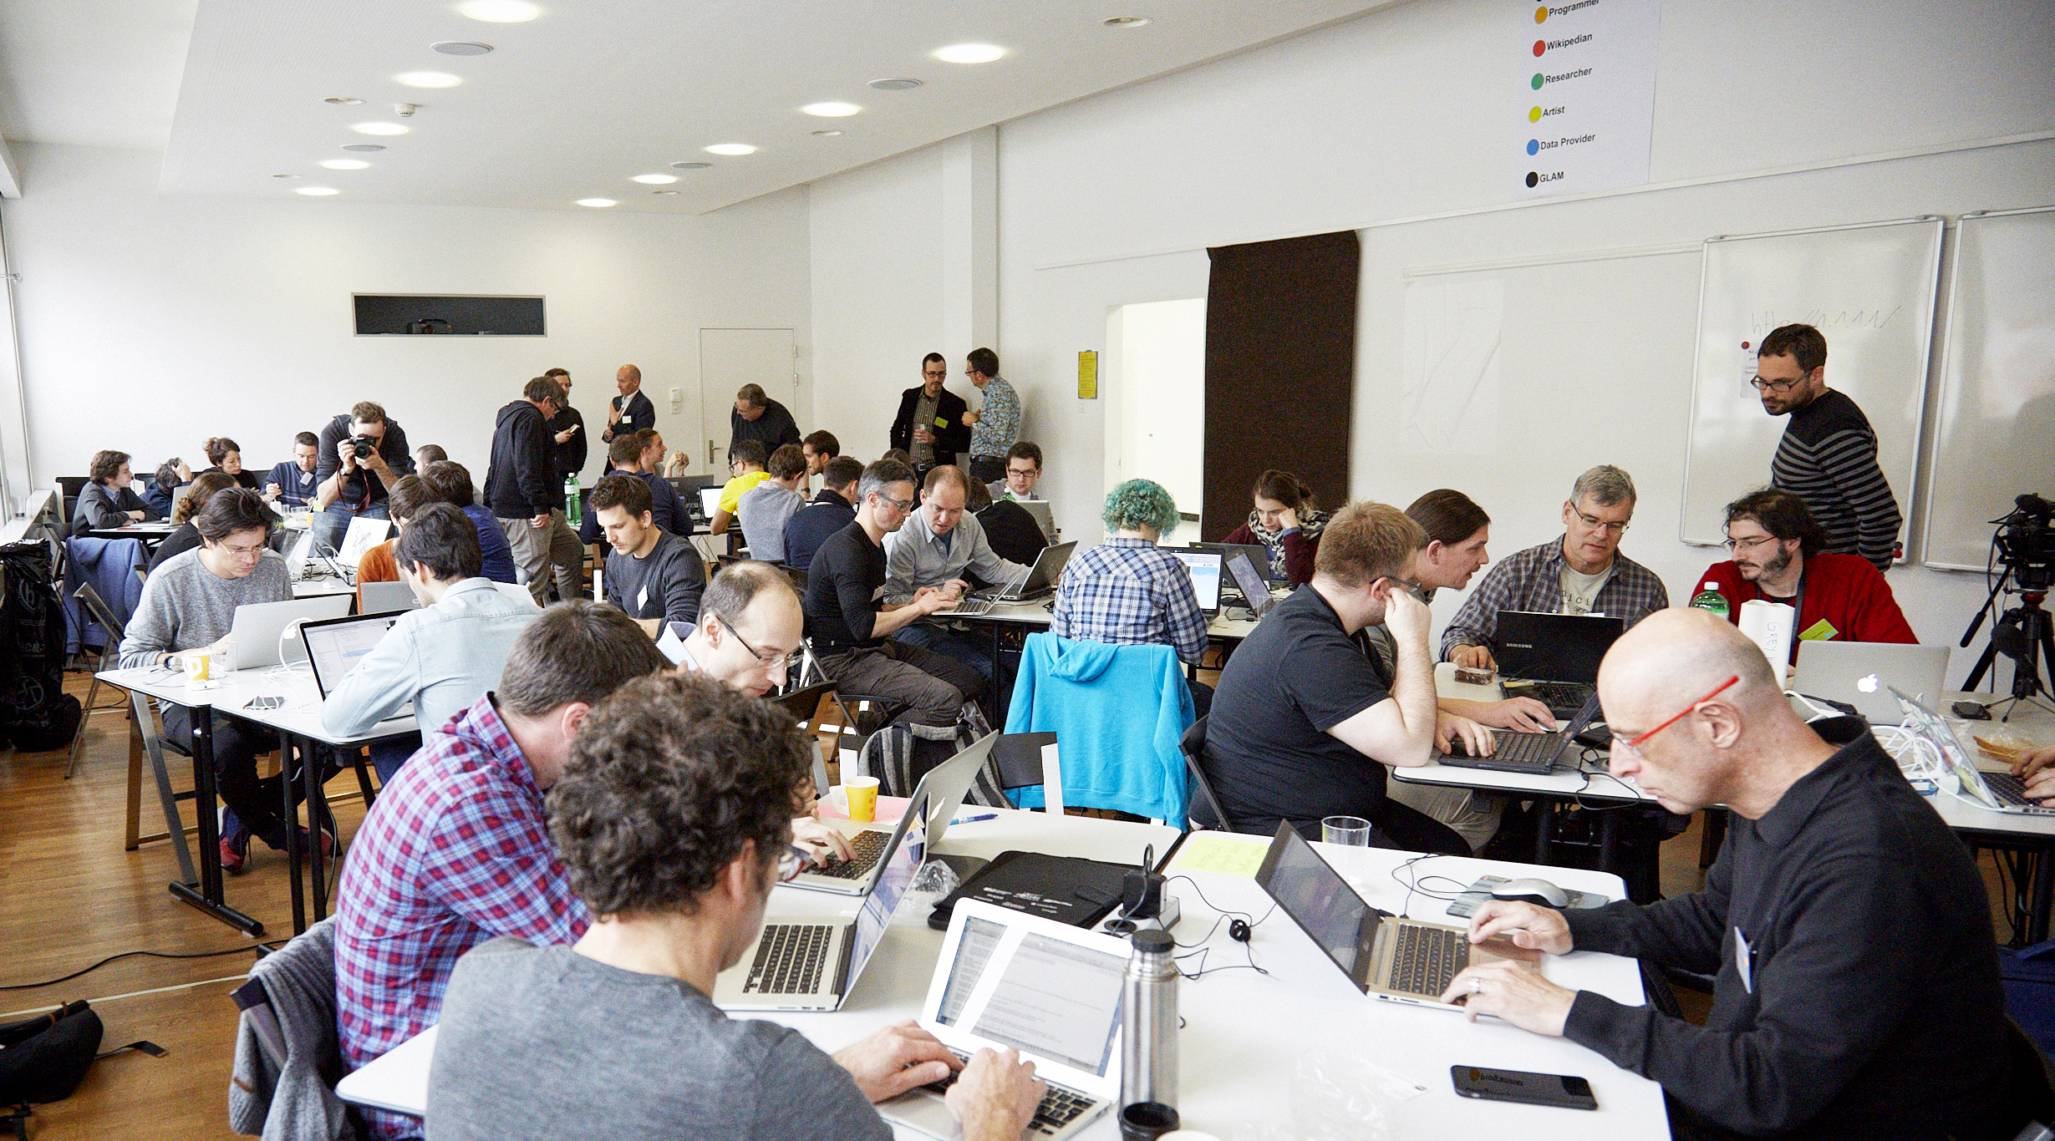
The #dataforbetterhealth initiative
Hackathon “Doc PH”: Introduction

Slide 2
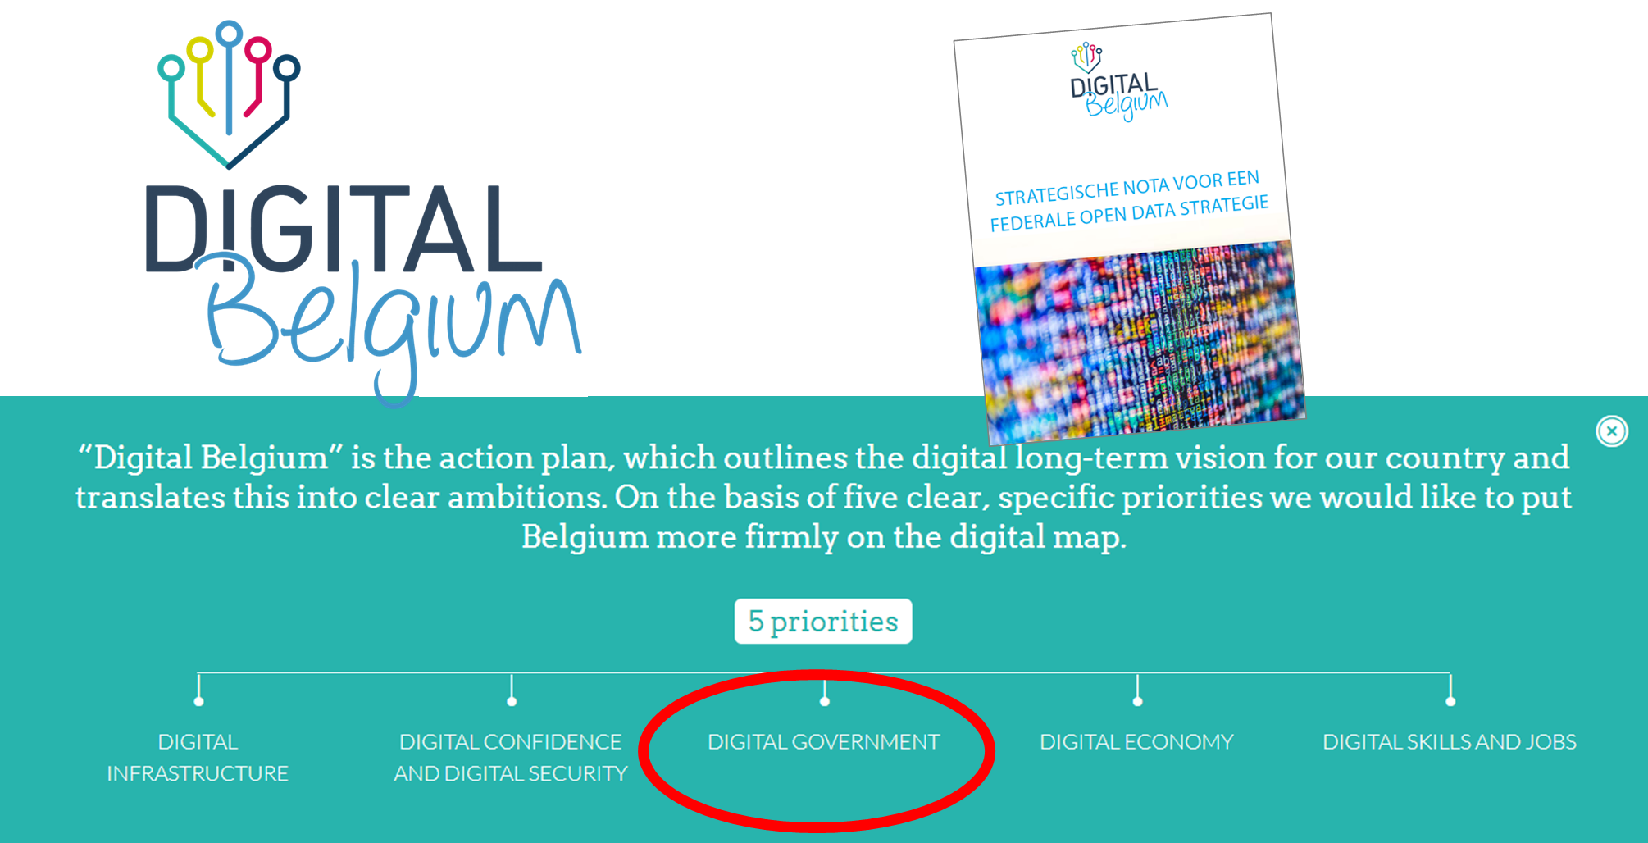




Recent ambitions of federal government

Slide 3
Recent ambitions of federal government

Slide 4
Recent ambitions of federal government

Slide 5
Recent ambitions of federal government

Slide 6
Recent ambitions of federal government

Slide 7



“Data is difficult to Find, to Access, not Interoperable, no Re-use”

Slide 8

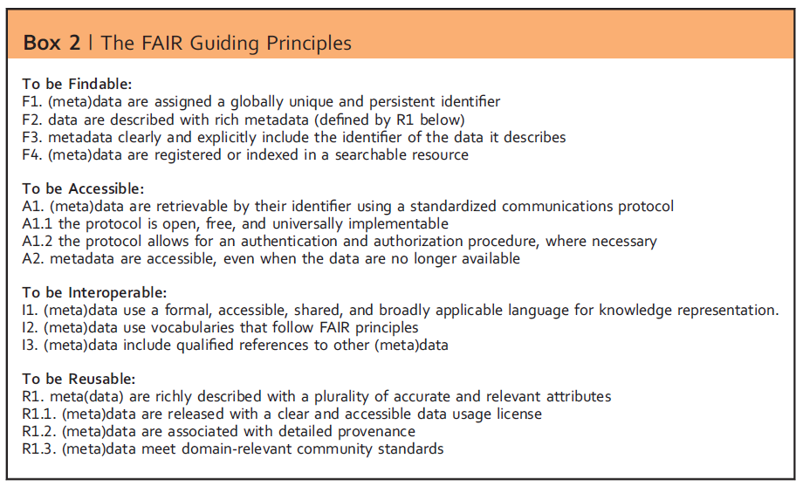
“how it should be!”

Slide 9


The initiative #dataforbetterhealth aims to identify the existing impediments for a FAIR data policy in public health and to formulate, test and implement solutions for these impediments in order to achieve an integrated data access policy.

Slide 10
an INITIATIVE of the federal minister of Public health, the federal minister of Digital Agenda, and the federal Secretary of state of Privacy

Slide 11
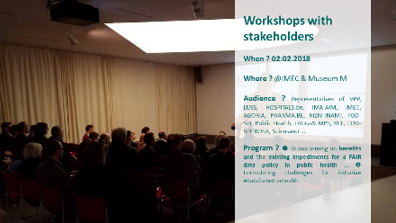

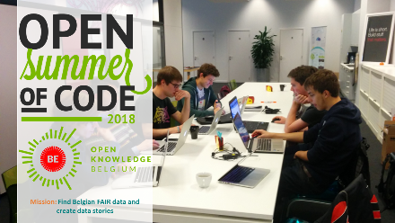
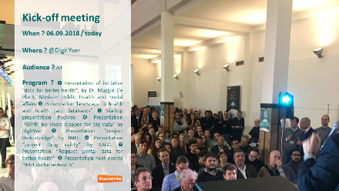
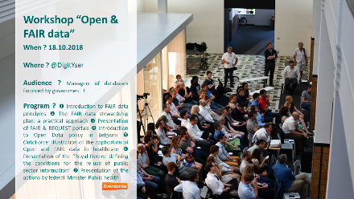
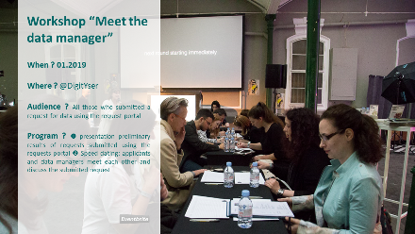

#dataforbetterhealth : Recent activities

Slide 12

Series of Hackathons
When ? #1: Intro: 10.01.2019 => hackathon: 25-26.01.2019
Where ? @DigitYser
Audience ? Multidisciplinary data science teams
Program ? ❶ During a workshop, a governmental (administrative) database will be presented by the responsible data managers and primary users, metadata of the database will be provided ❷ Attendees of workshop can join the hackathon with the governmental (administrative) database.

Slide 13
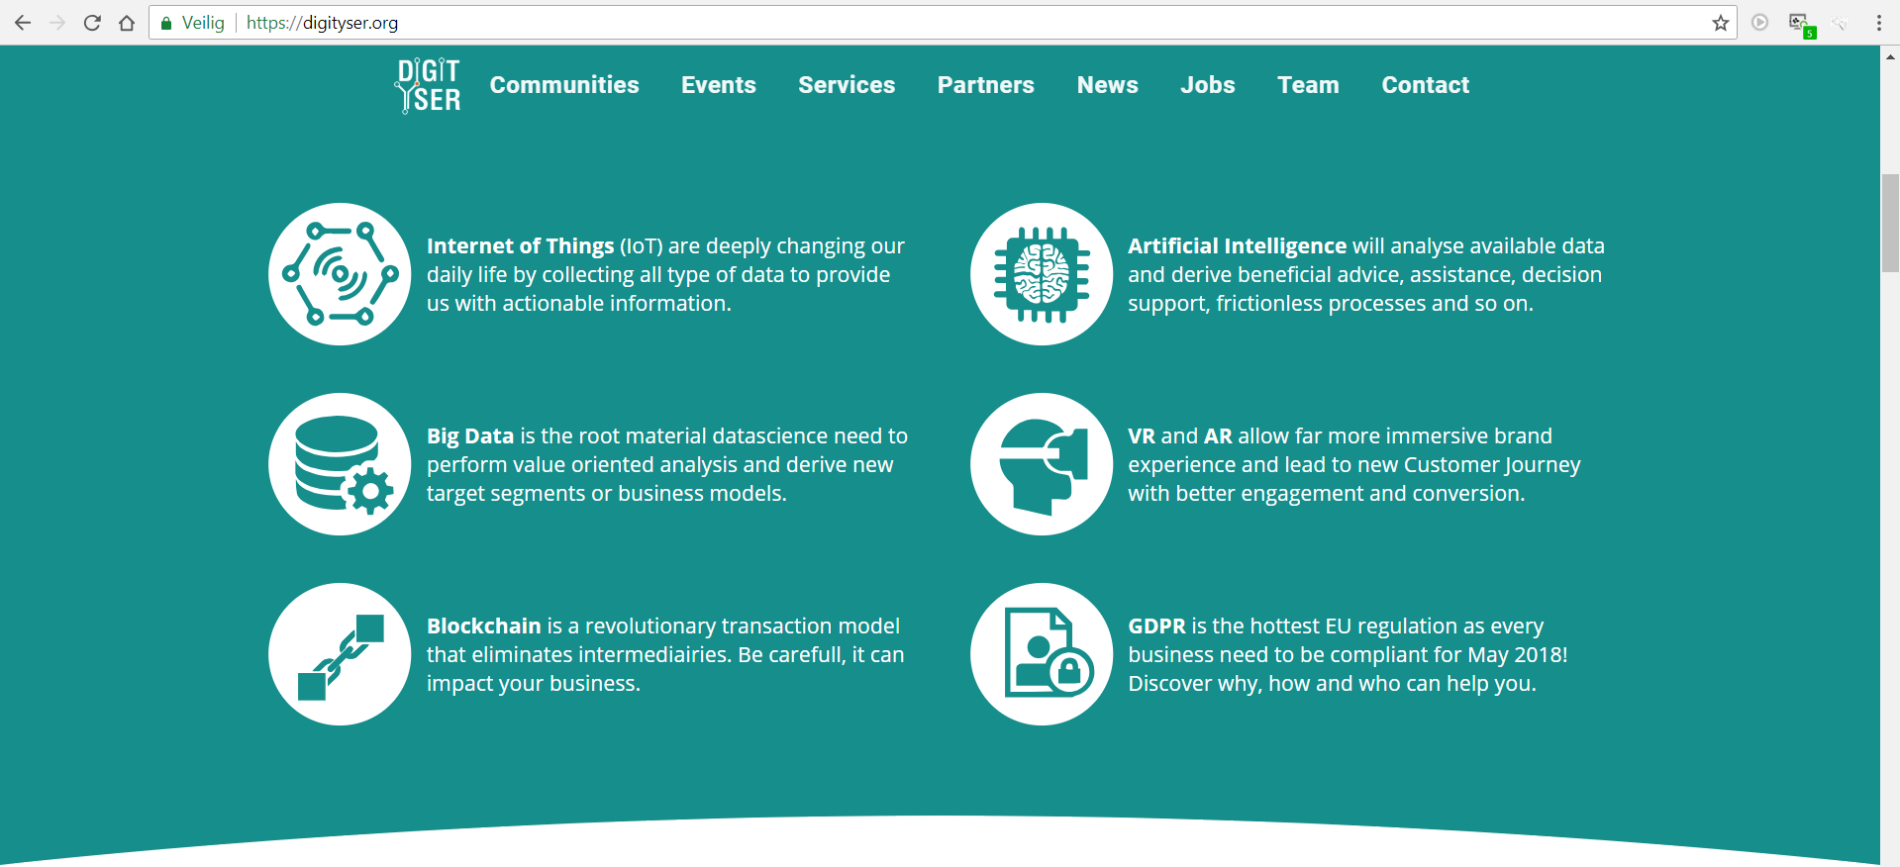


In collaboration with

Slide 14
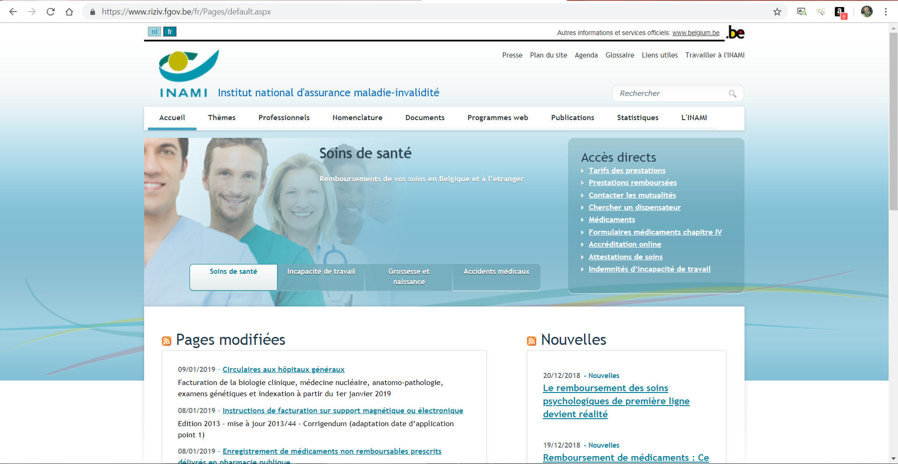
#dataforbetterhealth: 1st partner / data provider

Slide 15
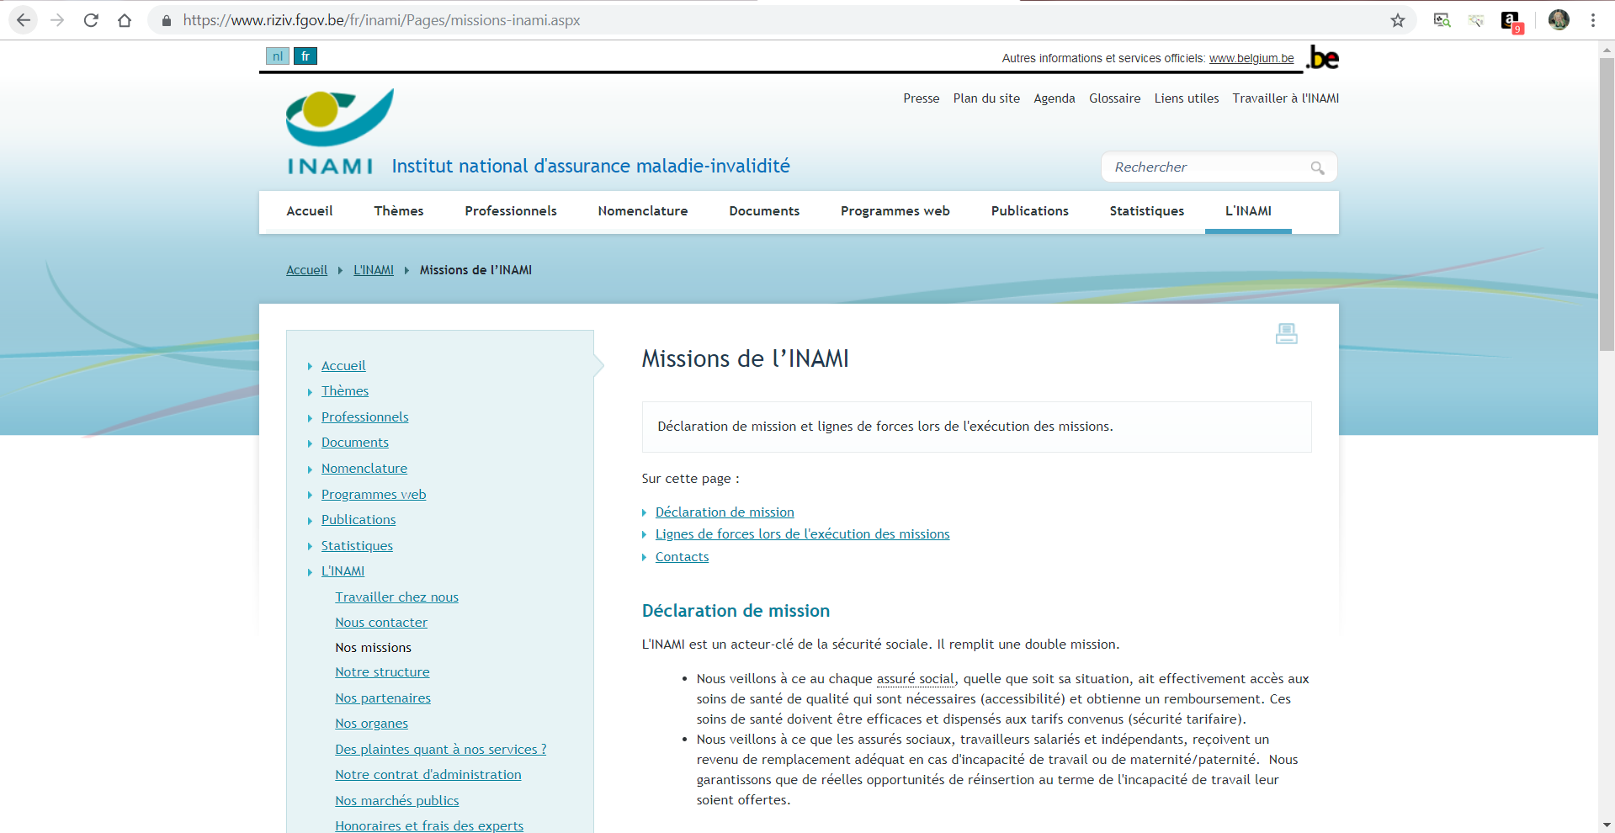
RIZIV/INAMI = Key actor in life of all Belgian inhabitants !

Slide 16
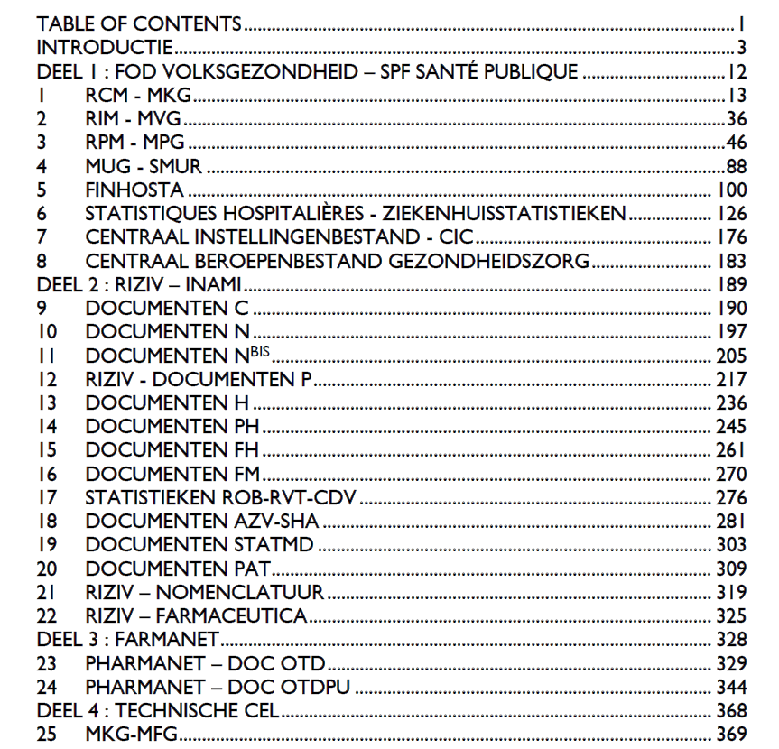


RIZIV/INAMI = collects data of all Belgian inhabitants!

Slide 17
RIZIV/INAMI and #dataforbetterhealth
Serial release of anonymized (patient, healthcare provider, healthcare institute, insurance committee) versions of listed databases
Method: each quarter organization of info session and hackathon with 1 database
Introduction database by expert RIZIV/INAMI (info session)
Attendance of expert RIZIV/INAMI at hackathon
Anonymization : 1st Anonymization by RIZIV/INAMI, 2nd Anonymization (control/validation) by DPO community DigitYser
Public release of database after hackathon

Slide 18
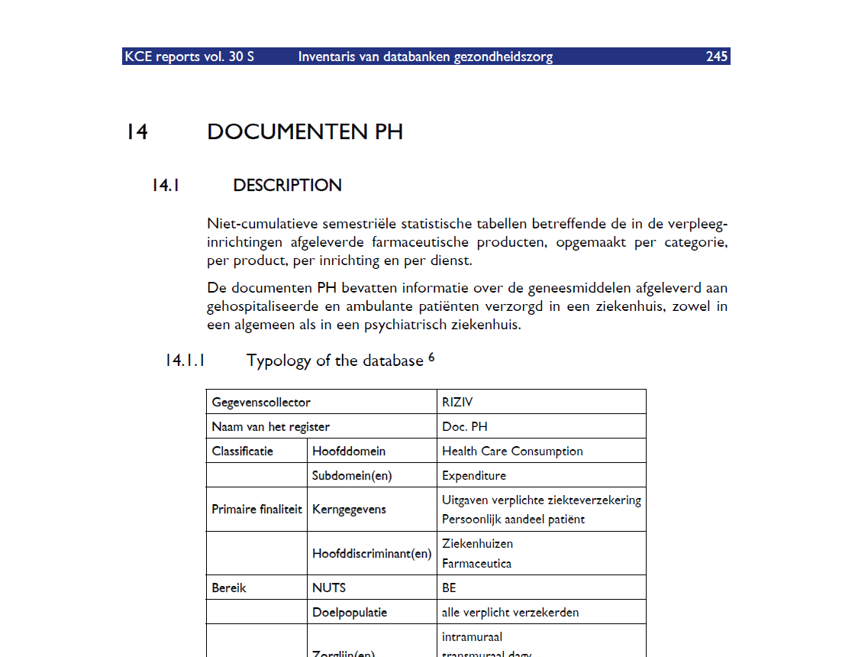
First database available for hackathon
More info presented by RIZIV / INAMI

Slide 19

Q & A

Slide 20
follow us!
#dataforbetterhealth
an INITIATIVE of the federal minister of Public health, the federal minister of Digital Agenda, and the federal Secretary of state of Privacy

